Slide 1
CMU presentation
January 31, 2014
Notes:
1

Slide 2
The Landscape Today
Technology and globalization are wiping out lower-skilled jobs faster, while steadily raising the skill level required for new jobs. More than ever now, lifelong learning is the key to getting into, and staying in, the middle class.
…That’s why I prefer the new mantra floated by Clinton at the Democratic convention: “We have to prepare more Americans for the new jobs that are being created in a world fuelled by new technology. That’s why investments in our people” — in more community colleges and vocational-training classes — are more important than ever.”
                Thomas Friedman, September 8, 2012

Slide 3
Outline
Higher Education Impacts
Colleges Ontario
Overview of Ontario Colleges
  Students
  Programs
  Resources and Results
Challenges Ahead
The future…we hope
Notes:
3

Slide 4
Higher Education Impacts
Individual Benefits
  Higher incomes and more likely to be in the workforce;
  Improved occupational status;
  Reduced risk of unemployment and living in poverty;
  Higher self-esteem;
  Greater willingness to be open to differing opinions;
  Higher levels of civic participation and volunteerism;
  Greater involvement with children’s extra-curricular activities;
  Greater participation in leisure time exercise;
  Improved health outcomes, including reduced likelihood of smoking.
Notes:
4

Slide 5
Higher Education Impacts
Societal Benefits
  Enables and improves social mobility, especially among under-represented groups;
    E.g. First Generation, Aboriginals
  Contributes towards a more tolerant society;
  Reduced demand for health and social support programs;
  Higher tax revenues;
  Supports and drives productivity and prosperity gains;
    Over 2 million college graduates in the Ontario workforce
    82,000 students graduated in 2012-13
Notes:
5

Slide 6
Why Advocate Together
Colleges rely on government funding and policy decision making
We are in a very competitive environment with most areas that rely on government funding being underfunded and arguing for further support
Not many decision makers and policy analysts at Queen’s Park went to college
Colleges matter to the future
The voice of the college sector is stronger than the voice of any one college

Slide 7
Colleges Ontario
Colleges Ontario is the advocacy and marketing association of Ontario's 24 Colleges of Applied Arts and Technology
The mandate of Colleges Ontario is to advance a strong college system for Ontario.
Our services to colleges include:
• advocacy and communications
• research and policy development
• information coordination
• professional development
Notes:
7

Slide 8
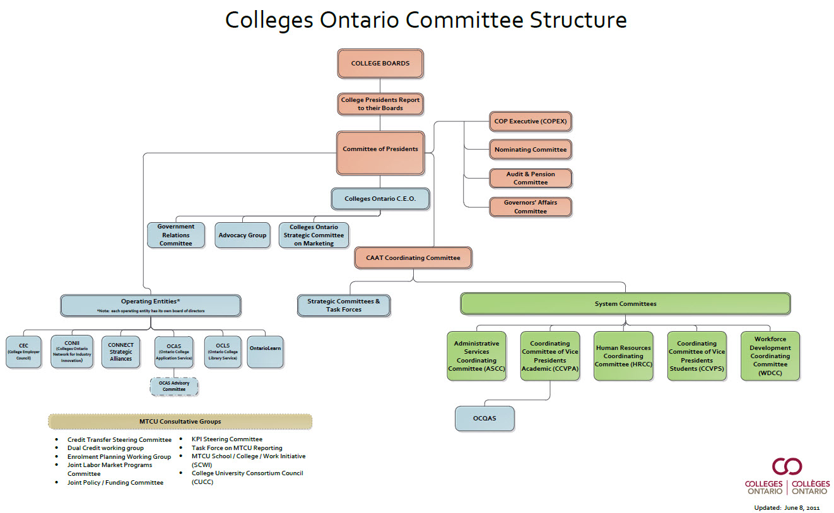
Colleges Ontario Committee Structure

Slide 9
Ontario’s 24 Colleges of Applied Arts and Technology
Notes:
9

Slide 10
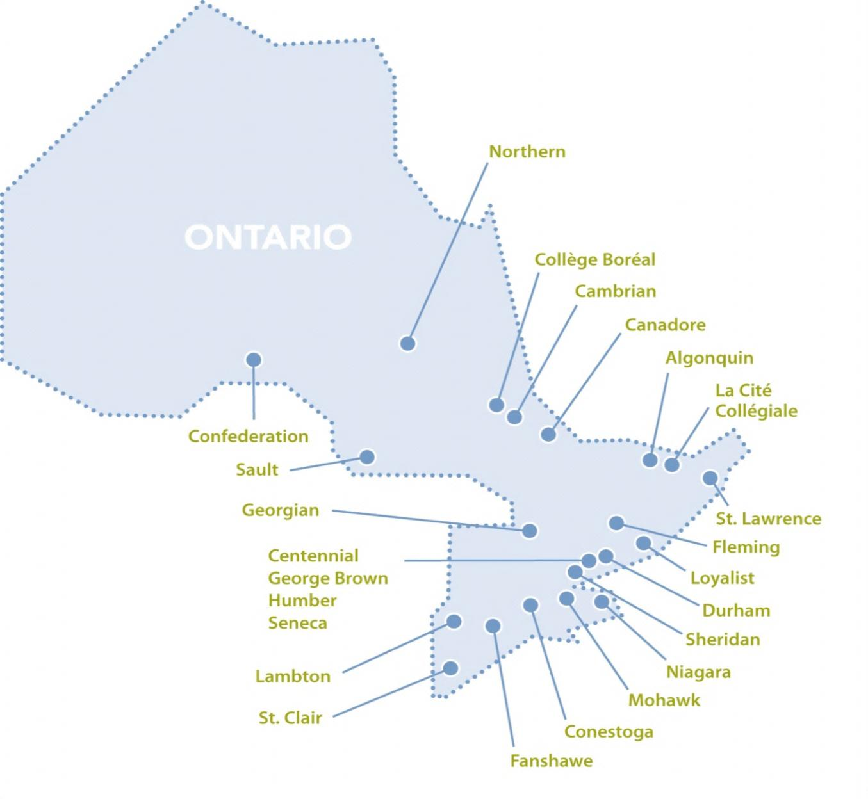
We Are Located Throughout Ontario
Notes:
10
There are 24 Colleges of Applied Arts and Technology – two of which are French language colleges
College vary greatly in size, depending on the region that they are in:
The 3 largest colleges are located in the GTA:
Humber (31,000 students)
Seneca (27,000 students)
George Brown (25,000 students)
The smallest colleges are located in the north:
Sault and Canadore (3,300 students each)
Northern (2,600 students)
Boreal (2,100 students)
Note: These figures are for full enrolment and include: postsecondary, apprenticeship, collaborative programs, international, unfunded, etc.

Slide 11
Our Mandate
The objects of the colleges are to offer a comprehensive program of career-oriented, post-secondary education and training to assist individuals in finding and keeping employment, to meet the needs of employers and the changing work environment and to support the economic and social development of their local and diverse communities.
    Ontario Colleges of Applied Arts and Technology Act, 2002
11

Slide 12
Learners/Clients Served by
Ontario’s Colleges
Estimated Annual Headcount = 500,000+
Source: MTCU; OCAS; CSES; Continuing Education Surveys; Colleges Ontario
Notes:
12

Slide 13
Colleges Reach A Variety of Groups
The average age of college applicants is 24 years
55% of applicants report a household income of $60,000 or less
16% of applicants were not born in Canada
23% of applicants are first generation – with neither parent having attended PSE
20% of college students report neither French nor English as their first language
13% of college students use special needs/disability services
2% of college students self-identify as Aboriginal – the same proportion as in the Ontario population
Source: OCAS; Applicant Survey (Academica Group Inc.); Student Satisfaction Survey (MTCU)
13
Notes:
13
CMEC presentation at ACCC on PIAAC suggests that Canadian colleges result in a much more diverse and inclusive labour force than the OECD college average.
We have a larger per cent of:
Population with a college-level credential (35% vs. OECD average of 15%)
College graduates who are immigrants (21% vs. OECD average of 12%)
College graduates whose mother tongue is different from the language of the assessment (18% vs. 8%)
College graduates who are indigenous persons (3% for Canada – NA for OECD)

Slide 14
Comparing respondents with a college-level education
Percent of population with a college-level credential
Canada | 35
OECD average | 15
Percent of college graduates who are immigrants
Canada | 21
OECD average | 12
Percent of college graduates whose mother tongue is different from the language of the assessment
Canada | 18
OECD average | 8
Percent of college graduates who are indigenous persons
Canada* | 3
OECD average | n.a.
* Aboriginal peoples living off-reserve
Source: OECD Programme for the International Assessment of Adult Competencies (PIAAC) in Canada

Slide 15
Many Pathways to College
Direct: Entered college directly from secondary school
Delayed: No prior PSE experience, but did not enter directly from secondary school
Incomplete PSE: Previous PSE experience, without a completed credential
Complete PSE: Previous attainment of a diploma or degree
Source: Student Satisfaction Survey 2012-13 (MTCU); Colleges Ontario
Notes:
In 2012-13, only one-third of students entered college directly from high school
22% were delayed entrants – they did not come directly from high school and had no prior PSE experience
Forty-two per cent of students had some previous post-secondary education
24 per cent had previously completed a college and/or university credential (12 per cent from universities).

Slide 16
Main Goals for Enrolling in College
Source: 2012 Applicant Survey (Academic Group Inc.)

Slide 17
Majority of PSE Entrants Choose College
Note: University and college data include first-year full-time undergraduate headcounts for fall 2012. Significant numbers of students also enroll in colleges during the winter and spring intake periods, not shown in the above figure. New full-time CAAT apprentices planned for 2012-13 are included with the college data. Source: MTCU, OCAS.
Notes:
The majority (58%) of new fall 2012 entrants to post-secondary education in Ontario enrolled in a college.

Slide 18
College Applicants: Direct from Secondary School
College Application Patterns: Example from South-western Ontario School Boards
Local = within School Board area
Nearby = commuting distance
Other = student would have to live away from home
Although there was variation across the province, in general, the majority of college applicants only applied to colleges in their home communities.

Slide 19
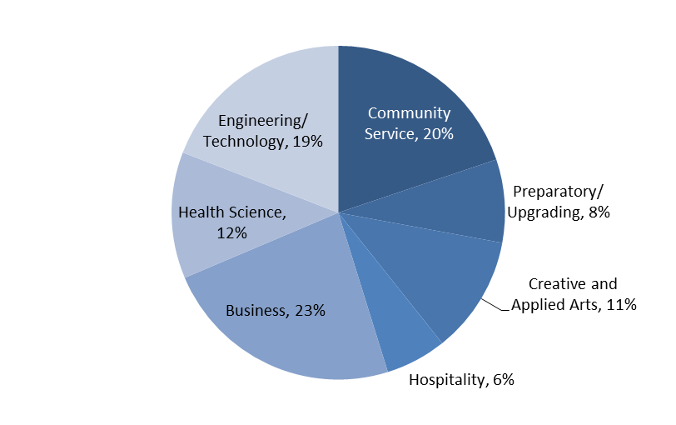
College Graduates by Employment Sector
82,000 graduates last year
Source: 2012 Employment Profile (MTCU); Colleges Ontario
Notes:
19

Slide 20
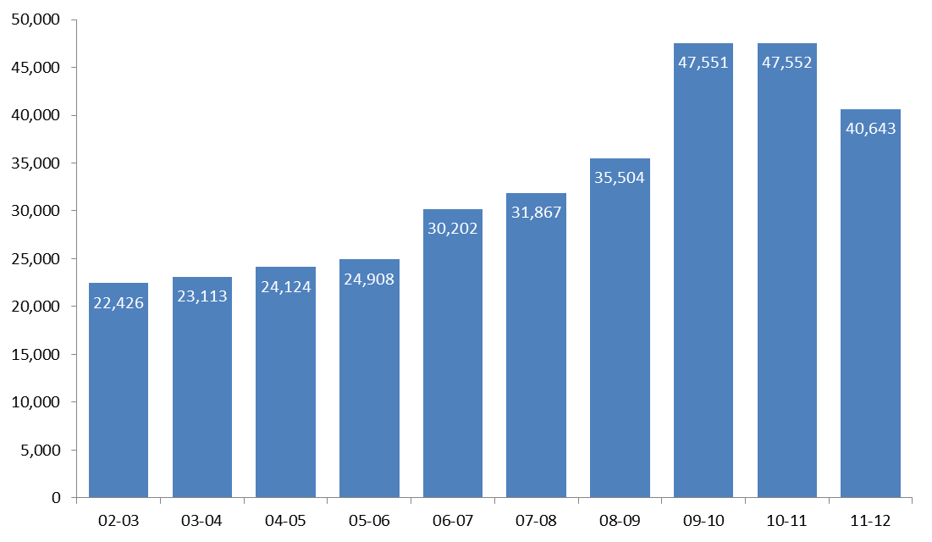
New CAAT Apprenticeship Starts
Source: MTCU (total full- and part-time)
New CAAT apprenticeship reached 40,643 in 2011-12.
Ontario colleges deliver 87% of Ontario’s apprenticeship in-school training.
Notes:
20

Slide 21
College System Revenues

Slide 22
Interprovincial Funding Comparisons

Slide 23
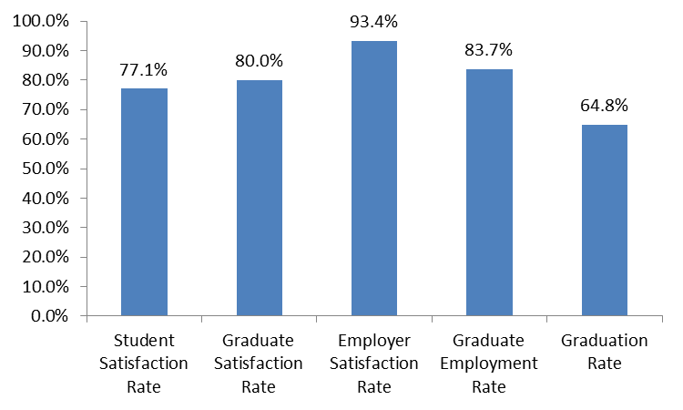
Key Performance Indicators
2012-13 Reporting Year
Ontario’s Colleges and Ontario’s Ministry of Training, Colleges and Universities have defined five Key Performance Indicators
Three of these indicators (graduate employment, graduate satisfaction, and employer satisfaction), are used to distribute performance funding to the colleges.
The student survey is administered in class to all students beyond first semester, and the graduate & employer surveys are telephone surveys administered six months after graduation.

Slide 24
Challenges Ahead
Ontario’s labour market future
Fiscal pressures
Potential new government directions, college response

Slide 25
Ontario’s Labour Market Future
25

Slide 26
Why be concerned?
Overall Transitions From Secondary School
University, 34%
College, 20%
Apprenticeship,6%
Destination
Of Students
After 4 or 5 Years of Secondary School
Workplace (with OSSD), 15%
Workplace (without OSSD), 25%
Note: These percentages are the authors’ estimates of the transition of students in 2008. University and college enrollment data were obtained from OUAC and OCAS. The university percentage was adjusted to include students who attended university outside of Ontario. Apprenticeship was based on 18 and 19 year olds registered in apprenticeship with MTCU. The large majority of those placed in the Workplace categories were in the workforce, but the percentages also include those enrolled in private colleges and the military.

Slide 27
“People Without Jobs” is already here

Slide 28
How difficult is it to find recent graduates who are qualified for jobs in your organization?
Employers n = 1004
28

Slide 29
But at the same time….
Youth unemployment is stubbornly high
Parents and young people are worried about the job market today
That is changing their views of pse…

Slide 30
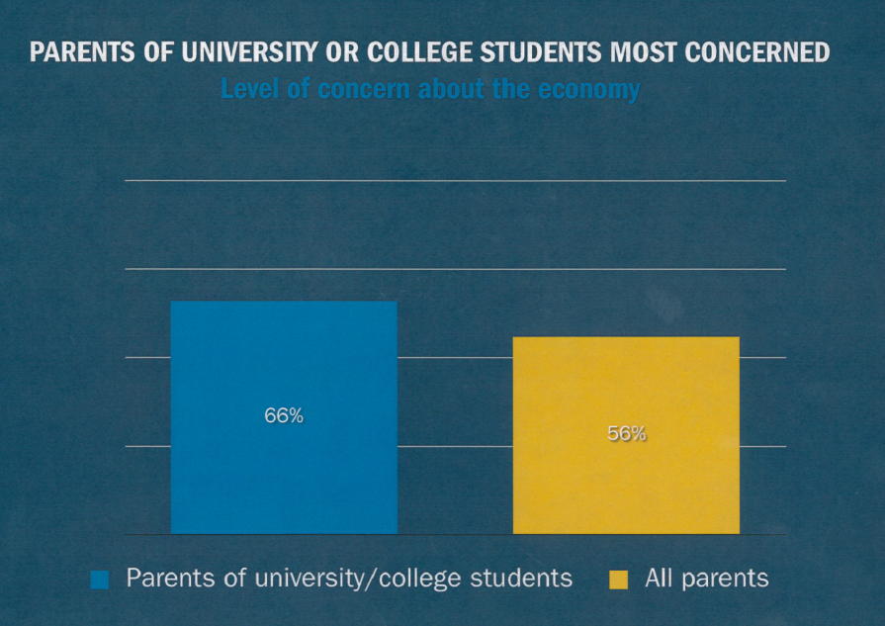
Parents of Students most worried about the Economy

Slide 31
The main purpose of post-secondary education should be:
General Public n = 1000
31
Notes:
The recession has changed public attitudes about the relative value of college and university education.

Slide 32
Which institution does a better job of teaching their students specific skills and knowledge for the workplace?
General Public n = 1000
32
Notes:
Respondents from the Southwest (79%) and East (76%) were most likely to say Colleges.

Slide 33
College Strengths and Public Concerns are aligned
Focus on the labour market shortage and the need to increase pse attainment plays to the strengths of colleges:
  Destination of choice for underrepresented
  Immigrant integration
  Workforce training; training “at risk” workers
  Retraining – Second career, literacy, other programs
33

Slide 34
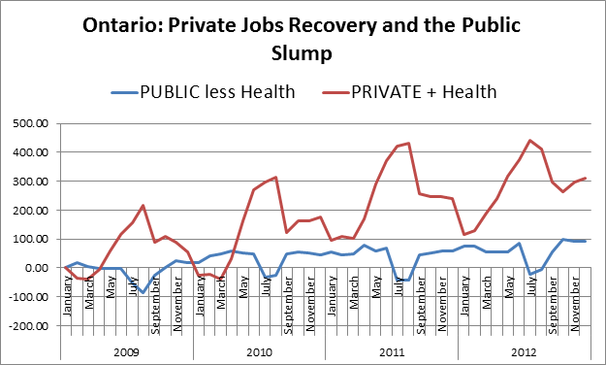
Why colleges matter more than ever
The CFIB has indicated that 6 college graduates will be needed for every 1 university graduate in the coming years

Slide 35
What Do We Need to Consider in addressing labour market challenges of the future?
Secondary School Student Characteristics: Gender
PSE Destinations by Gender
Males and females were equally likely to register in college, while females were more likely than males to register in university. Males were much more likely not to apply to PSE at all, and slightly more likely to have left secondary school before their fourth year.
35

Slide 36
Secondary School: Average Marks
College-Preparation OSSD Students:
Grade 12 Average Marks by College Application Status
Average marks did not differentiate students who did not apply to college from those who did apply and/or from those who actually registered in a college.
36

Slide 37
The future…we hope
Colleges’ vision for the future
Challenges in getting there
Where do we go from here?

Slide 38
What do political changes mean for us?
Have a decision on tuition framework
Negotiators appointed to go through SMAs – 44 in 6 months
More command and control from government
Challenges facing our students, businesses, local communities remain the same
Colleges must continue to find solutions to these challenges, in spite of changing government priorities and realities
Government is still interested in reform

Slide 39
Vision for Post-Secondary Education
  Colleges have contributed to the government’s discussions on system transformation over several years
  Key components of the government current focus:
  Online education - announcements made
  Credit transfer – announcements made
  Differentiation – SMAs to drive this, but still uncertain

Slide 40

What is the colleges’ vision for PSE?
Equal, complementary systems that are highly interconnected
Better and more transparent pathways
Apprenticeship reform
Better funding to meet the access needs of at-risk students
More innovative approaches to online education
Three-year labour market degrees
Excerpt from a speech Wm G. Davis gave in the legislature on May 21, 1965, when he introduced the legislation establishing the colleges:
  “I believe Mr. Speaker that the proposed legislation for the CAAT must be viewed in light of the economic and social demands not only of today but tomorrow”

Slide 41
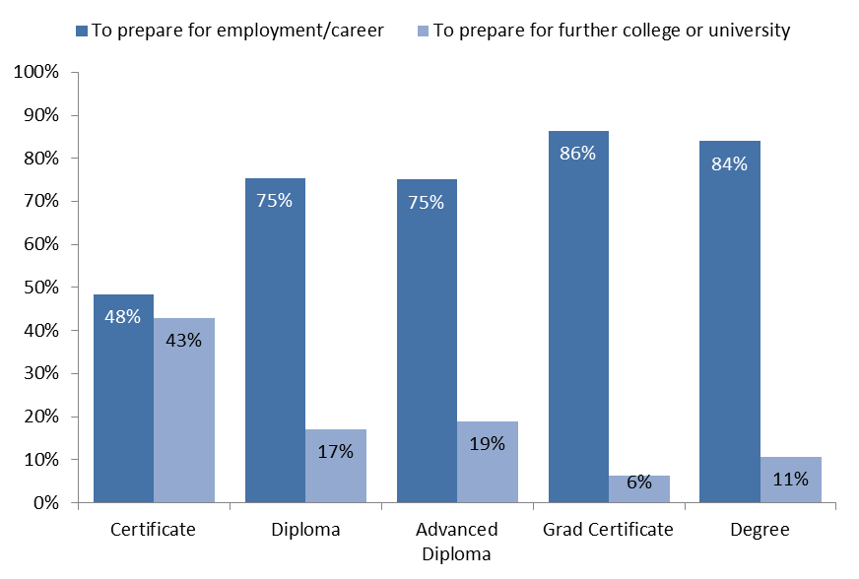
Why credit transfer matters: main goal by credential
Preparing for future PSE study is a primary goal for many college students. Interest in further study varies significantly by credential.
Source: MTCU – Student Satisfaction Survey

Slide 42
Three year degrees: our proposal
    Some areas of study will lend themselves to new 3 year degrees
    Colleges are already teaching focused, so this is a natural fit
    Colleges can do this as a priority, not an afterthought
    Many advanced diplomas already compatible with degree requirements – can provide greater access to degrees
    3 year diplomas are anomalies in the world, so will enhance international compatibility to change
    Will require new process for degree approvals using well established College quality assurance model as base and a more flexible admissions policy to improve access

Slide 43
Academic credentials ranked by preference.
General Public n = 1000

Slide 44
How would you rate a three-year college degree, in comparison to a three-year university degree?
General Public n = 1000

Slide 45
Have you ever wanted to apply for a job but didn’t because you did not have a degree?
General Public n = 1000
Notes:
No significant difference between high school and college

Slide 46
Apprenticeship: reform is slow
Reform apprenticeship – make it a clearer part of the post secondary structure
    Ontario’s colleges can take responsibility for administering the apprenticeship system
    We can have students apply for apprenticeship spots through OCAS
    We can and should expand the availability of pre-apprenticeship programs and college co-op programs to improve pathways to apprenticeship for more students

Slide 47
Online strategy
Ontario government has determined that new online entity will be created, with “hubs” for college and university courses
$42 million in next 3 years to advance this vision
    Ontario Learn already has the infrastructure needed to advance online learning – it may be the college hub
        Collaborative curriculum development
        Consortium based
        Efficient and cost effective
        Model could be adapted to include credential granting
        We can do more together—bridging, accepting courses, animation, units on line not just programs

Slide 48
Why does this matter to governments?
Worldwide, education costs have risen 84% since 2000
Almost 1 billion adults lack literacy skills
Many will need retraining through careers
Student debt is climbing
Government budgets under pressure
Huge increase in internet/technology use (US student tablet use grew 257% last year

Slide 49
What are we focusing on at CO?
What do our students, our communities and our institutions need to succeed?
Continue to engage the public on the skills shortage challenge & how colleges can help – think about specific issues for areas of serious shortages (like the North)
Prepare to weigh in on the Canada Job Grant program to support critical programs
Advocate for the system’s vision on differentiation, credentials & nomenclature, credit transfer, international education
Make the case to government to place a moratorium on more cuts to the system
Prepare the ground for the issues that will take longer to resolve:
    Fiscal health of system long term– think about outcome based funding
    Apprenticeship reform

Slide 50
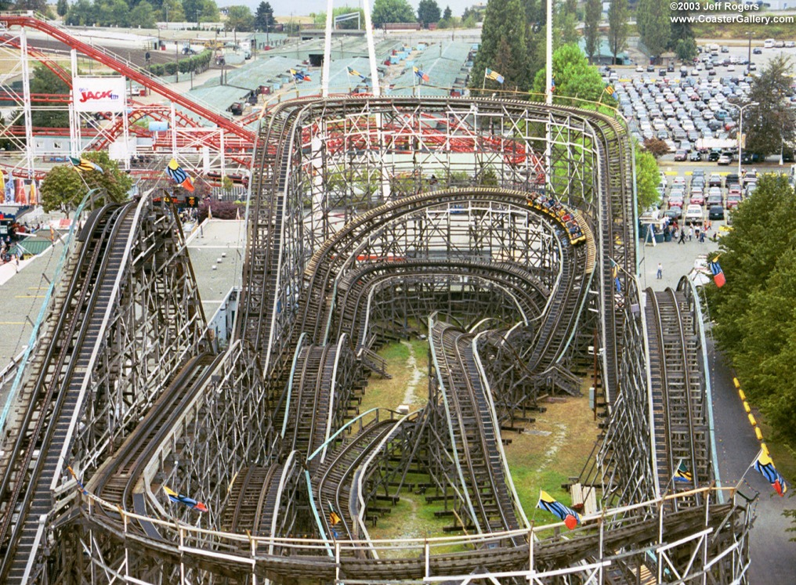
What can we count on right now?

Slide 51
Fiscal Pressures
The government in facing serious debt and deficit pressures – so the growth of government funding will be severely constrained
Even under the government’s Reaching Higher program, real operating grants per student declined by over 10 percent in five years
All public sector unions were told to reach settlements with no wage increases - most didn’t. Most are bargaining in 2014
While demand for college education is still growing, colleges will be facing difficult financial circumstances and will need to diversity revenue streams and continue to improve efficiencies.

Slide 52
Fiscal Health:
Health Care Spending
Notes:
52

Slide 53
Conclusions
The needs of Ontario’s economy in the future are well aligned with the strengths of colleges
However,
The fiscal situation is uncertain and we are not entirely in control of our destiny
But,
Colleges were designed to address labour market needs – If we don’t want the Miner report to be Ontario’s future reality -- we must find solutions working together

